Slide 1
Sequential Circuit
Sequential Circuit is a circuit that consists of combinational circuits that accepts external inputs and inputs the output of the memory elements and produces output and input for the memory element.
Example: Traffic light
Sequential
Circuit
Combinatio-nal
circuit
Combinatio-nal
circuit
Memory element

Slide 2
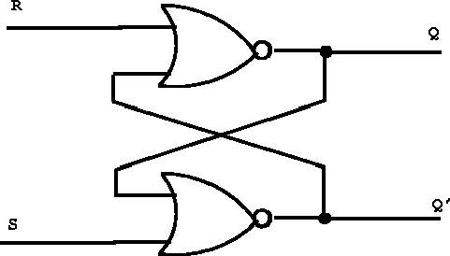
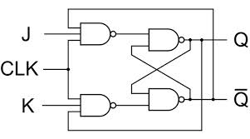
Memory element
The basic memory element of a digital system is known as a latch or flip-flop.
A flip-flop or latch is made of NAND or NOR gate.
Considering the NOR gate latch:
Truth table:
A B Out
0 0 1
0 1 0
1 0 0
1 1 0 [prohibited in memory cells]
In the figure, S=Set and R=Reset.
Let, S=1, R=0 then Q’=0 and Q=1.
=0
1
1
1
0
0
=1
NOR gate Latch
NAND gate Latch
This is also known as S-R Latch.

Slide 3
Memory element
=0
Truth table:
A B Out
0 0 1
0 1 0
1 0 0
1 1 0 [prohibited in memory cells]
Let, S=0, R=0 then, Q’=0 and Q=1
Let Again, R=1, S=0 then Q’=1 and Q=0
Let Again, S=0, R=0 then Q’=1 and Q=0
This represents that,
current output is
dependent on previous
output.
1
1
0
=0
0
NOR gate Latch
1
0
0
0
0
0
1
0
0
NOR gate Latch
0
1
Notes:
R=1 S=0 starts from Q=0.

Slide 4
Memory element
S-R latch characteristic table:
S R Q Q’
0 0 memory
0 1 0 1
1 0 1 0
1 1 not used
1 and 1 output gives 0 and 0 output which defies the Q and Q’ concept.
As we can see, we are using (0,0) combination to as memory element.
1 is call setting and 0 is called resetting bit in memory cell.
Practice: Try to find the NAND gate memory cell explanation.
NOR gate Latch

Slide 5
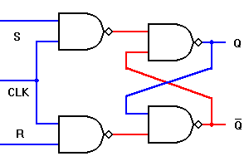
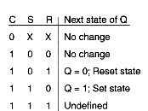
Clocked Latch/ Flipflop:SR
In a latch circuit, we give a combination of 0 and 1 as input to store either a 0 or a 1.
This value only changes if we change the input.
To control the input that stores the output, clock is used.
The figure and the characteristic table represents a NAND gate S-R flipflop.
In case of NAND gate latch, if the clock is
zero (clk=0) all states are memory state,
means clk=0, the output wont change even
if the input changes.
If the clk=1 and S=R=0, that is also a
memory state.
The rest is the same as the characteristic table.
Clock give the signal when to save a value in the
output.
memory
memory
Not used
10/08/2014 Section A

Slide 6
Clocked Latch/ Flipflop:SR
In order for a clocked circuit to work properly, the input should be provided first, then the clock should be changed.
So, if we want to store a 1 in the circuit, S=1 and R=0 has to be given as input.
In case of latch, if we wanted to store any data, we had to make the input (0,0).
In flip-flops case, this Clk=0 stores the data,
and Clk=1 take the input.
memory
memory
Not used
10/08/2014 Section A

Slide 7
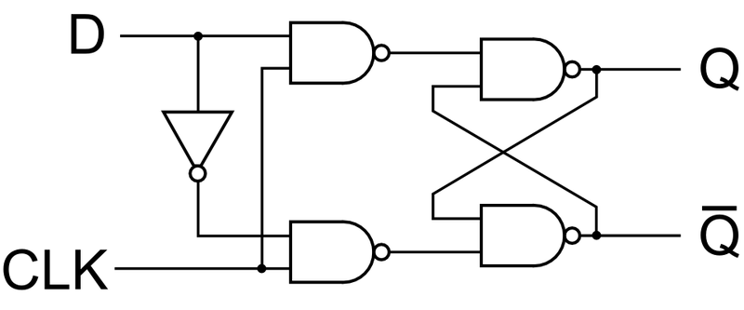
Clocked Latch/ Flipflop: D
The only needed inputs for S and R, while clk is added would be S=0, R=1, Q=0, Q’=1
S=1, R=0, Q=1,Q’=0
We are not concerned with S=1, R=1
or S=0, R=0 states
Two separate inputs are not needed for
this. We can use one value and invert
it to put two separate inputs.
This is known as D flipflop. Data storage if mostly done using D flipflop. Example: memory of computer.
Basic working principle of D flipflop:
For inserting data Clk=1, D=0 or1
For storing data Clk=0
10/08/2014 Section A

Slide 8
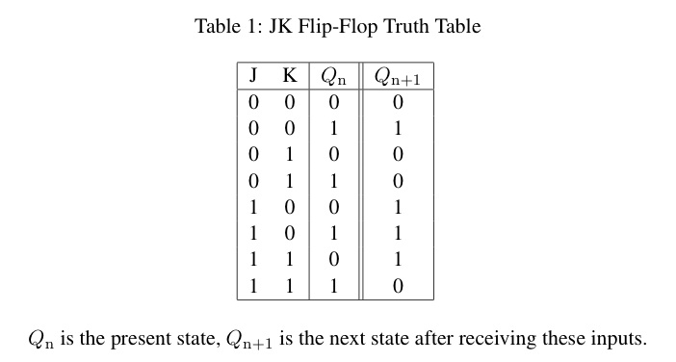
Clocked Latch/ Flipflop: JK
The uncertainty in the state of S-R flipflop,
when S=R=1 can be eliminated if we convert
it into J-K filpflop.
Here we replace the 2 input NAND gates at
first stage to 3 input NAND gates.
Now, Clk=1, S=1,R=0 then Q=1 and Q’=0
Clk=1, S=0 and R=1 then Q=0 and Q’=1
Clk=1, S=1, R=1,
Let Q=1 and Q’=0 (previous stage)
Then we get, Q=0, Q’=1.
This keeps the Q and Q’ condition
1
1
J
0
1
1
1
0
1
0
1
1
K

Slide 9
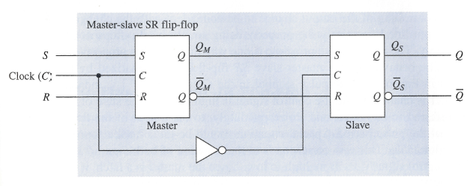
Master-Slave Flip-Flop
Two sections, each capable of storing a binary symbol.
First section is referred to as the master and the second section as the slave.
Information is entered into the master on one edge or level of a control signal and is transferred to the slave on the next edge or level of the control signal.
Each section is a latch.

Slide 10
Master-Slave SR Flip-Flop
C = 0:
  Master is disabled. Any changes to S,R ignored.
  Slave is enabled. Is in the same state as the master.
C = 1:
  Slave is disabled (retains state of master)
  Master is enabled, responds to inputs. Changes in state of master are not reflected in disabled slave.
C = 0:
  Master is disabled.
  Slave is enabled and takes on new state of the master.
Important: For short periods during rising and falling edges, both master and slave are disabled.

